Slide 1
Predicting Employee Attrition at Frito-Lay
Muskaan Mahes
DDAnalytics

Slide 2


Business Objective
Attrition cost Frito Lay between 50% to 400% of an employee’s salary.
The objective:
Find the key variable driving employee attrition.
Predict which employees are likely to leave.
Estimate how much will Frito-Lay will be saving by using machine learning models.

Slide 3
Dataset Overview
Observations: 870 employees
Features: 35 Employee-related variables
Variable Types:
Categorical: Department, Job Role, Gender, etc.
Numeric: Monthly Income, Years At Company, Hourly Rate, etc.

Slide 4
Attrition Summary
Employee attrition depicts that about 1 in 6 employees have left the company. The attrition rate is 16.1% and the retention rate is 83.9%.
Indicates that the dataset is imbalanced, as most employees stayed.
How Many Employees left vs stayed?
Attrition | Count | Percent
Yes | 140 | 16.1%
No | 730 | 83.9%

Slide 5
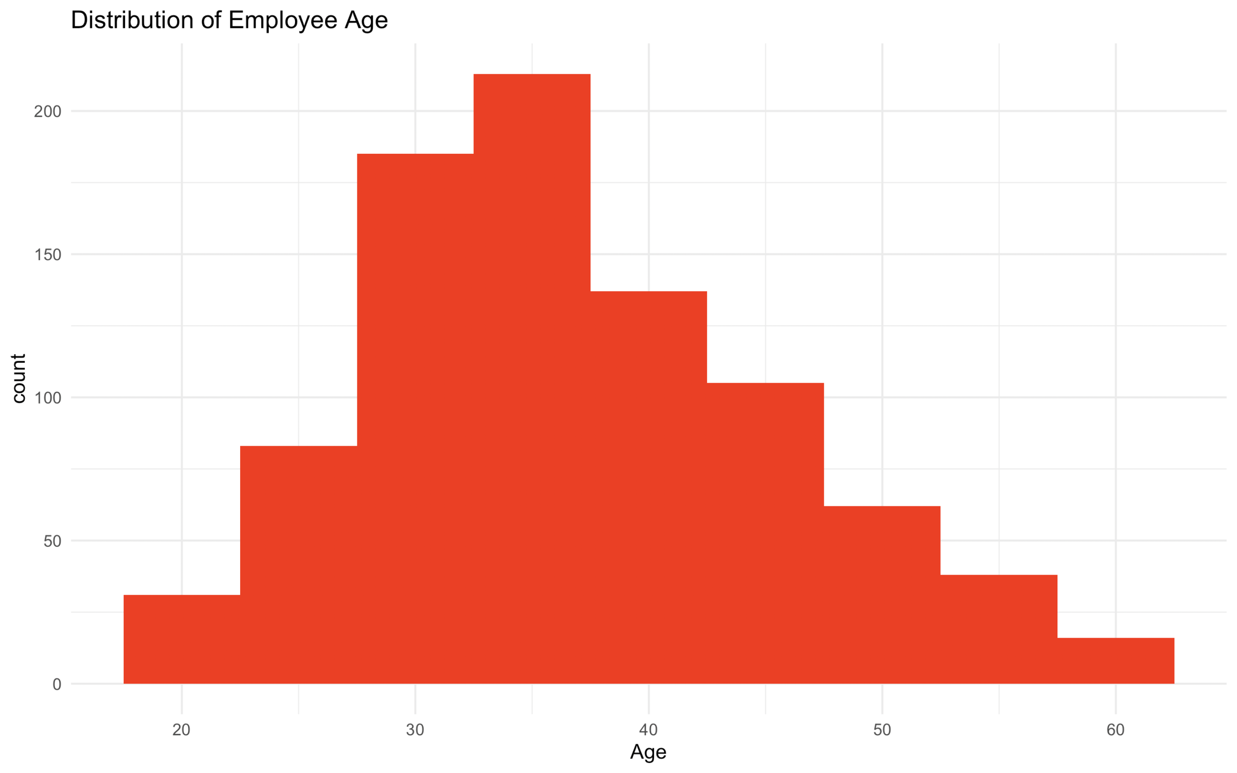
Numeric Variables Overview
Key Numeric Variables:
Age
Monthly Income
Years at Company

Slide 6
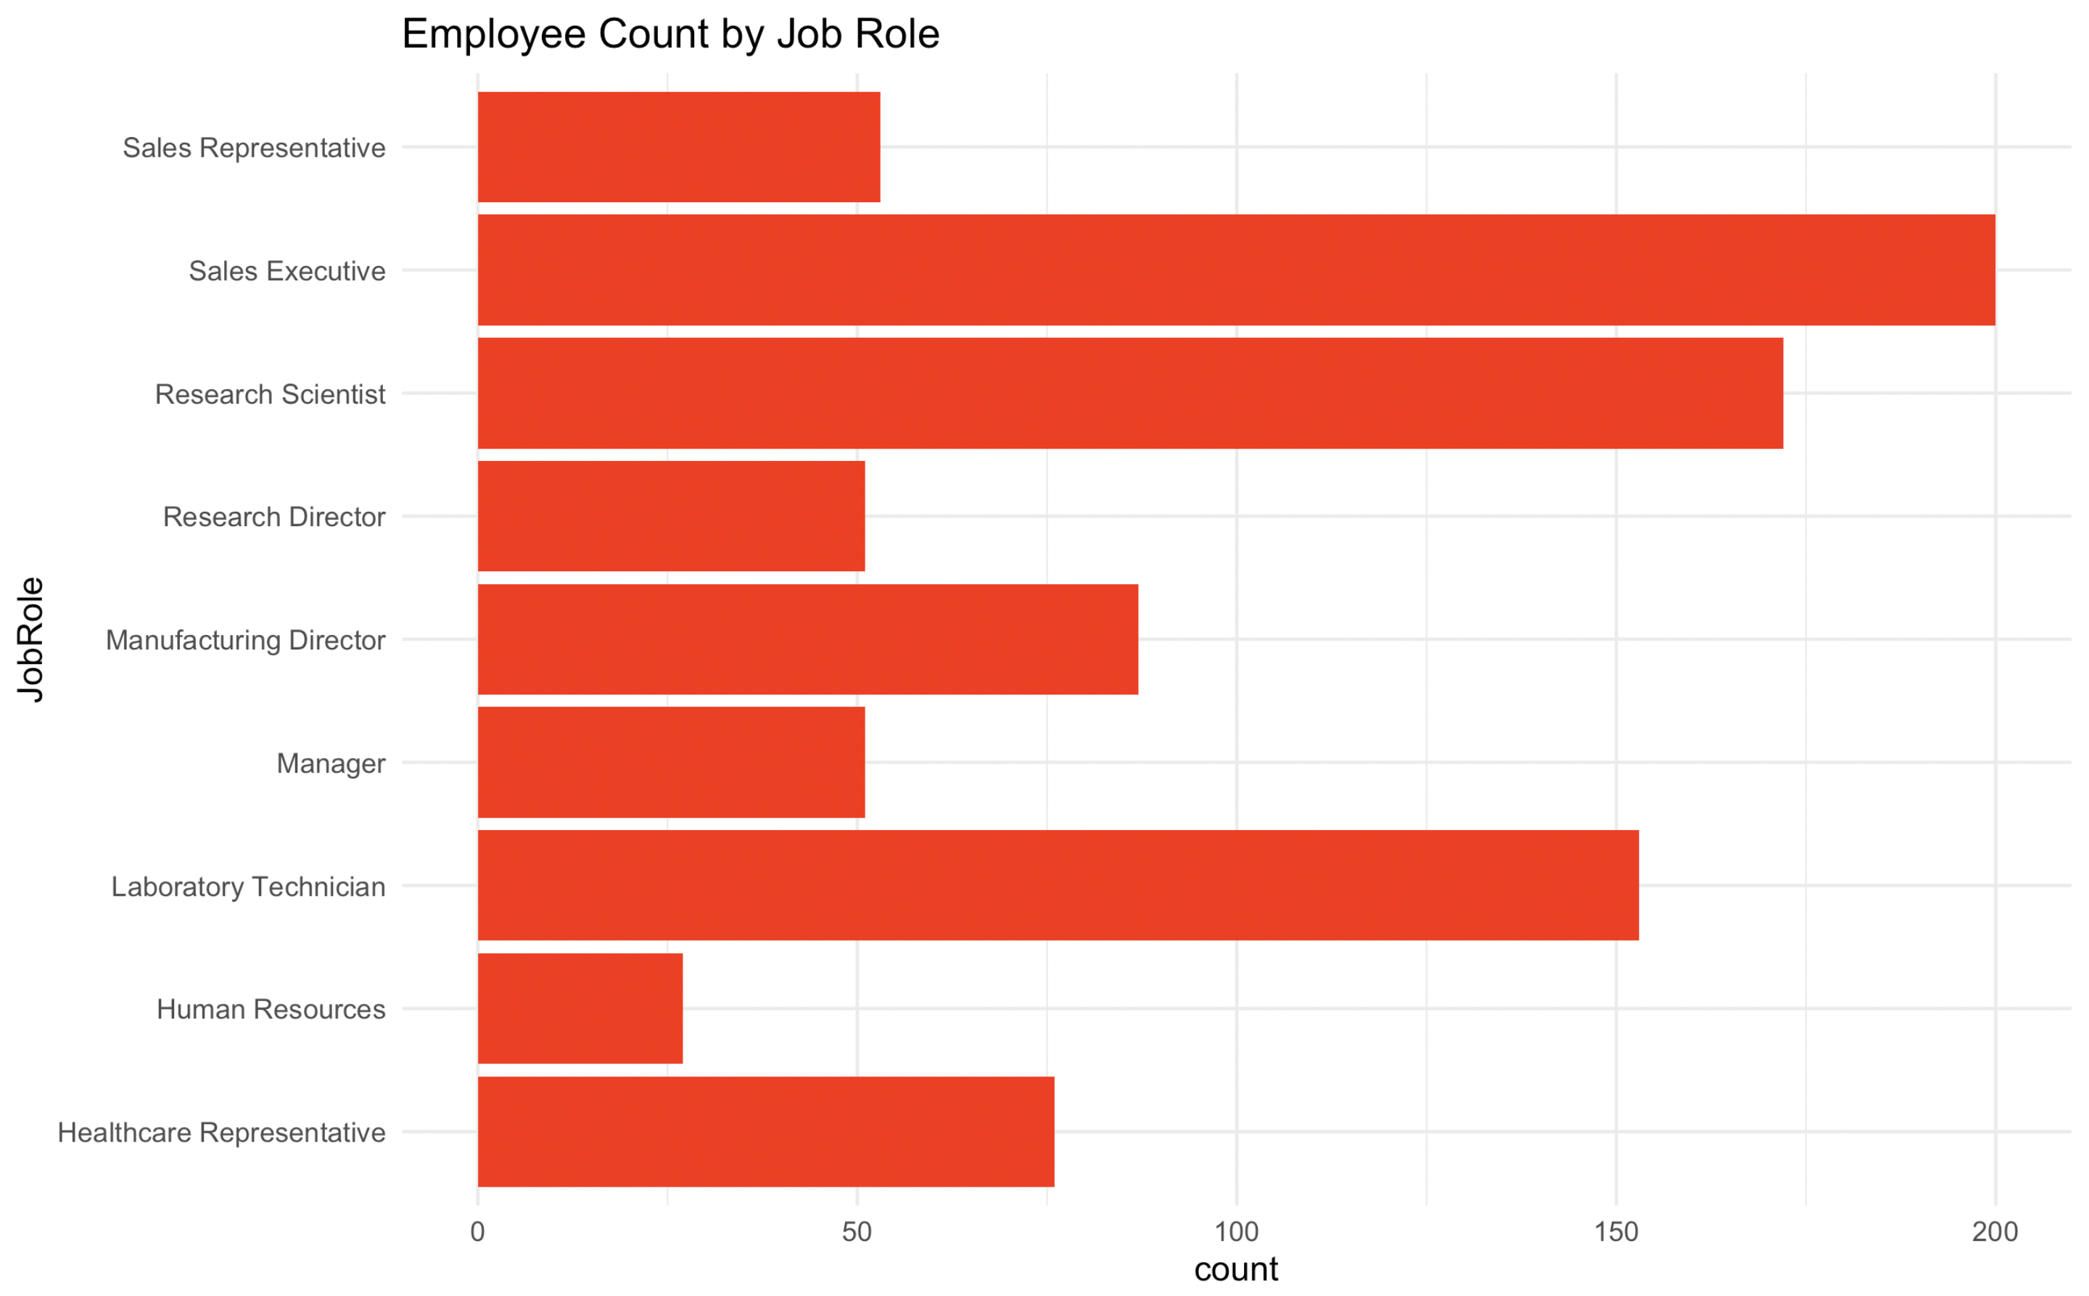
Demographic Insights
Key categorical variables:
Job Role
Department
Gender
Education

Slide 7
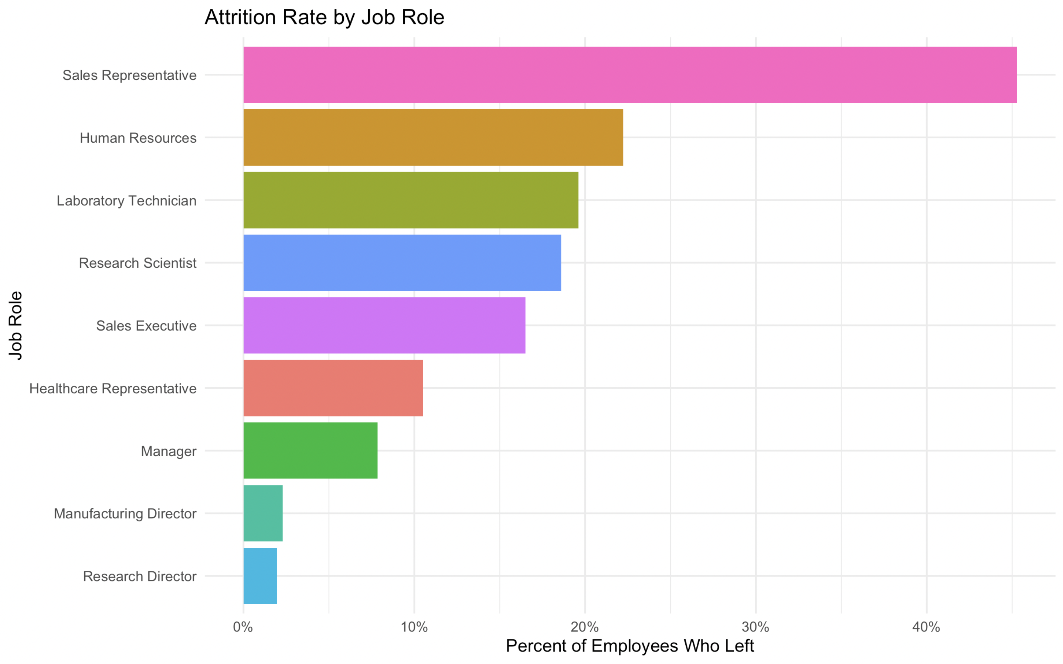
Attrition vs Job Role
Attrition is highest for employees who are Sale Representative or in Human Resources

Slide 8
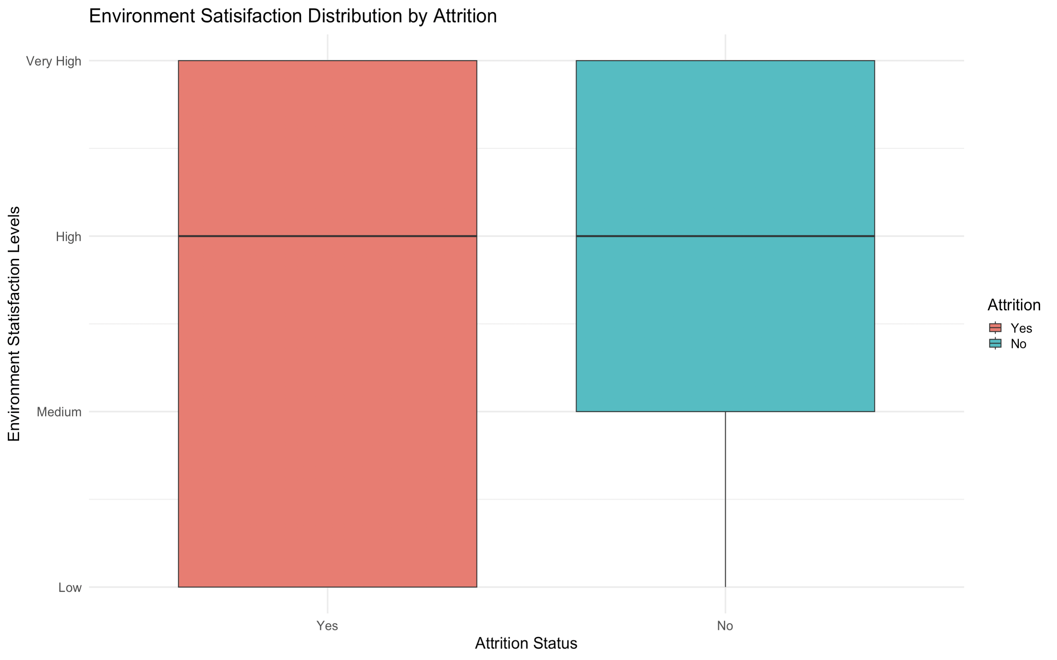
Attrition vs Environment Satisfaction
Employees with low levels of satisfaction are likely to leave.

Slide 9
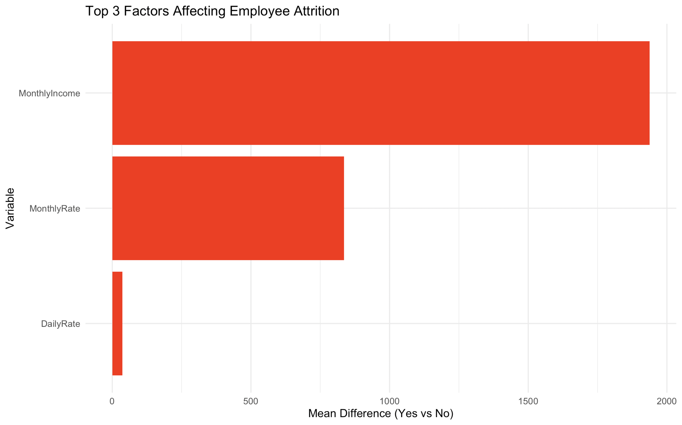
Top 3 Factors Affecting Attrition
Top 3 differentiating factors: monthly income, monthly rate, and daily rate

Slide 10
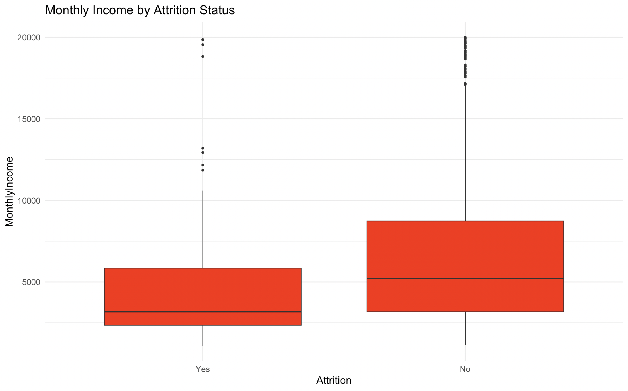
Attrition vs Monthly Income
Employees who left the company had a lower income on average

Slide 11
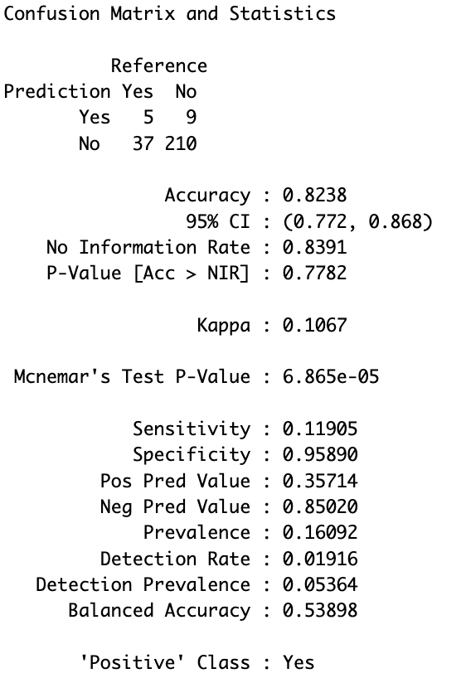
KNN Model Summary
Procedure:
Train/Test → 70/30 Split
K=3 Neighbors
Key Output:
Accuracy: Identified 82.38% of total correct predictions.
Sensitivity: Identified 11.91% of employees who left correctly.
Specificity: Identified 95.89% of employees who stayed correctly.

Slide 12
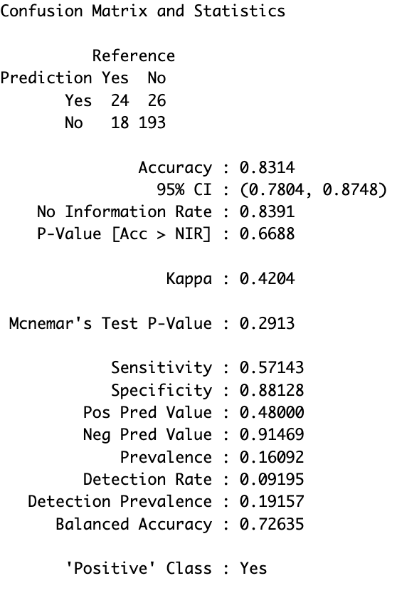
Naïve Bayes Model Summary
Key Output:
Accuracy: 83.14% of overall correct predictions
Sensitivity: Identified 57.14% of employees who left correctly.
Specificity: Identified 88.12% of employees who stayed correctly.

Slide 13
Sensitivity & Specificity Analysis
 | KNN | Naïve Bayes
Sensitivity | ~12% | ~57%
Specificity | ~96% | ~88%
Sensitivity: measures how well the model correctly identify which employees left.
KNN = correctly identified 12% of leavers.
Naïve Bayes = correctly identified 57% of leavers.
Specificity: measures how well the model identified employees who stayed.
KNN = correctly identified 96% of stayers.
Naïve Bayes = correctly identified 88% of stayers.

Slide 14
What Does This Mean?
Assumption | Value | Description
Number of Employees | 1,000
Turnover Rate | 20% | 200 expected to leave
Cost per Leaver | $15,000 | Replacement cost
Incentive Amount | $200 | Offered to those who are predicted to leave
Retention Effect | 20% | Incentive prevents 20% of leavers
Model | Sensitivity | Specificity | Incentive Cost | Numbers of Leavers Prevented | Savings | Net Impact
KNN | 12% | 96% | $11,200 | ~5 | $72,000 | $60,800
Naive Bayes | 57% | 88% | $42,000 | ~23 | $342,000 | $300,000
Give $200/ Employee |  |  | $200,000 | ~40 | $600,000 | $400,000

Slide 15

Insights & Business Impact Estimate
Attrition rate of 16% is driven by low satisfaction and lower income.
Current turnover will cost the company $4-30 million/year.
The Naïve Bayes model can help HR retain 10 employees through targeted retention incentives of $200/each.
Save $300K – 2.6 million annually.
Data shows that employee engagement and fair pay are the strongest predictors for retention.

Slide 16

Recommendations
Employees with low satisfaction → address the component which drives disengagement (can be found conducting surveys).
High performance rate → To keep these employees retain top talent implement targeted retention incentives.
New Hires → Engage with them earlier by mentoring (reduced attrition).

Slide 17
Thank you
Muskaan Mahes

